Slide 1
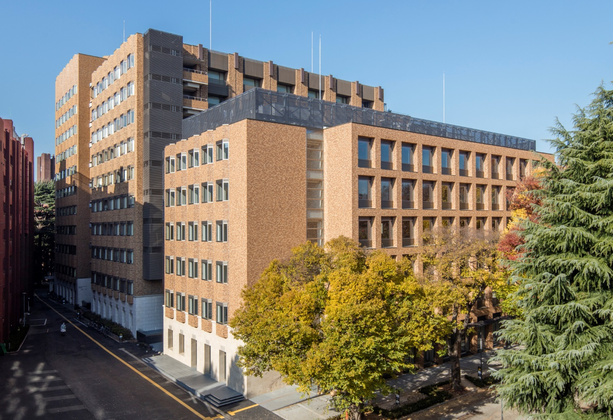
Overview of the
School of Science
The University of Tokyo
Notes:
Established in 1877

Slide 2
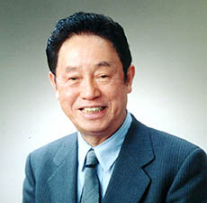
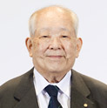
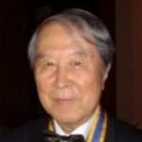
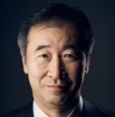
A brief introduction
The School of Science of the University of Tokyo (UTokyo) has been pushing scientific boundaries and deepening our understanding of nature since its founding in 1877. As demonstrated by the internationally recognized research produced by our faculty, students and alumni, the School provides an environment that fosters scientific leaders who will contribute to the advancement of society through their expertise and impactful research. With a variety of educational programs offered in English and research being conducted on a global scale, we welcome motivated students and researchers to join us in playing an active role in the world of science.
Message from the Dean
Since our founding, the School of Science has produced many achievements and talents as the center of scientific research and education, not only in Japan, but also throughout the world. Our goal is to contribute to the sustainable and peaceful development of human society through the research and educational activities of science, together with the faculty and students of the School of Science.
Hiroyuki Takeda
Number of
Students & Faculty
International Students
Student to Faculty Ratio
7
1
659
799
Asia (82.5%)
Europe (7.8%)
217
North America (6.5%)
Natural Science
Physics & Astronomy
Earth & Marine Sciences
Chemistry
Biological Sciences
286
Central South America (1.8%)
Rankings
Oceania (0.9%)
QS World University Rankings
by Subject 2019
Undergraduate
Students
Doctoral
Students
Faculty
Africa(0.5%)
Master's Students
9
10
14
11
15
20
Mathematics
Distinguished Alumni
26
Computer Science &
Information Systems
Nobel Prizes
Fields Medal
Leo Esaki
Physics 1973
Masatoshi Koshiba
Physics 2002
Yoichiro Nambu
Physics 2008
Takaaki Kajita
Physics 2015
Yoshinori Ohsumi
Physiology or
Medicine 2017
Kunihiko Kodaira
1954

Slide 3
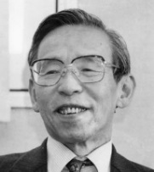
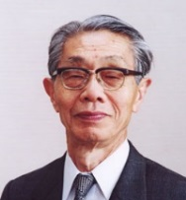
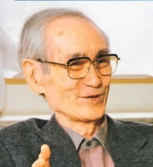
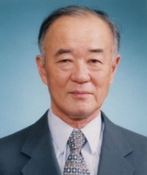
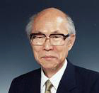
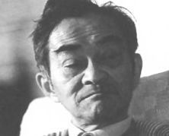
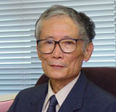
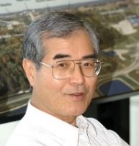
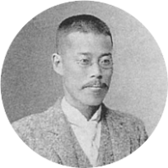
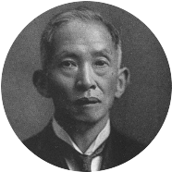
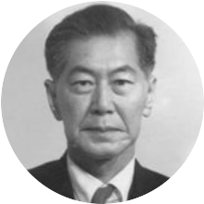
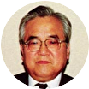
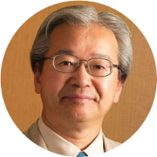
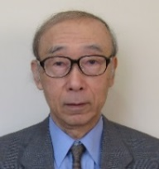
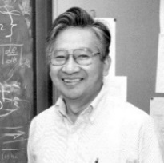
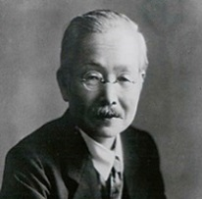
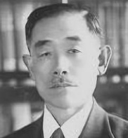
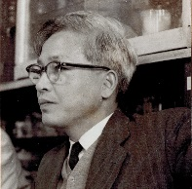
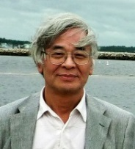
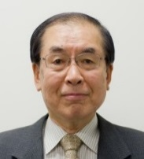
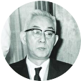
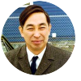
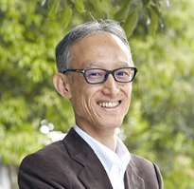
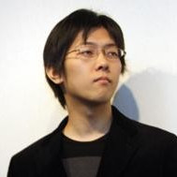
Distinguished Alumni
Selectable icons
＜Physics＞
choose from the icons below
Hidetoshi Takahashi
(1937)
Morikazu Toda
(1940)
Chushiro Hayashi
(1942)
Ryogo Kubo
(1941)
Koichi Shimoda
(1943)
Fumio Osawa
(1944)
Kazuhiko Nishijima
(1948)
Akito Arima
(1953)
Eiichi Goto
(1953)
＜Astronomy＞
Jun Kondo
(1959)
Akira Tonomura
(1965)
Yoji Totsuka
(1972)
Makoto Hirayama
(1888)
Hisashi Kimura
(1892)
Yusuke Hagihara
(1921)
Takeo Hatanaka
(1937)
Yoshihide Kozai
(1951)
Norio Kaifu
(1969)
＜Earth and Planetary Science＞
＜Chemistry＞
＜Biological Sciences＞
＜ mathematics ＞
Ikuo Kushiro
(1957)
Hiroo Kanamori
(1959)
Kikunae Ikeda
(1889)
Yuji Shibata
(1907)
Kiyoshi Takewaki
(1928)
Tuneyoshi Kuroiwa (1971)
Masayuki Yamamoto
(1975)
Kousaku Yoshida
(1931)
Kiyoshi Ito
(1938)
＜ Information Science ＞
Kamada Tomihisa （1982）
Toru Nishikawa （2005）
Kazuki Ohta （2006）

Slide 4
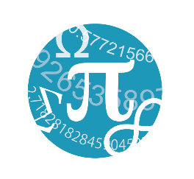
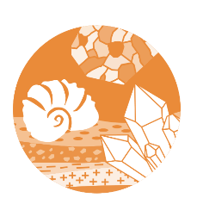
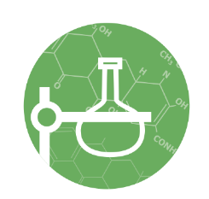
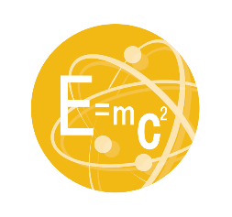
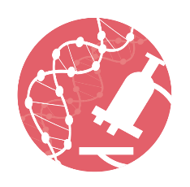
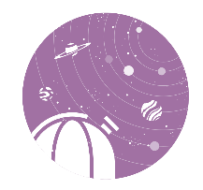
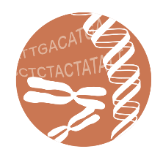
Undergraduate Departments
Mathematics
Earth and Planetary Environmental Science
Focuses on the interdependence between mathematics and natural science. Seminars and coursework deepen students’ understanding of the main trends in modern mathematics and develop their problem-solving and data collection skills.
Studies phenomena on the surface of the Earth and other planets from an environmental perspective. Students build a foundation in this field through lectures and practical training in chemical analysis, gene analysis and numerical simulation, as well as through fieldwork in both Japan and abroad.
Information Science
Chemistry
Aims to approach the essence of information processing through education and research in areas such as fundamental theory of computation, programming languages, visual information, computer architecture, machine learning, and bioinformatics.
Challenges to elucidate fundamental mechanisms, create new materials and technologies, and discover new phenomena through the research of atoms and molecules. All lectures are given in English to help students develop an international perspective.
Physics
Biophysics and Biochemistry
Covers almost all of the frontier areas of modern physics, including condensed matter physics, astrophysics and cosmology, elementary particle physics, nuclear physics, atomic and molecular physics, quantum information, biophysics, and plasma physics.
Uses an interdisciplinary approach to elucidate the fundamental principles of biological phenomena and understand the underlying mechanisms at a molecular level. Merges theory from mathematics, information science, and physical chemistry with biochemistry and molecular biology experimentation.
Astronomy
Biological Sciences
One of the few departments in Japan that focuses on the study of the universe, from celestial bodies and astronomical phenomena to the universe as a whole. Major research areas include optical and infrared astronomy, theoretical astronomy, radio astronomy and space astronomy.
Studies the biological mechanisms and phenomena of the myriad of organisms that have appeared and evolved on Earth over the past four billion years. Students specialize in flora, fauna, or anthropology, and study animals and plants in their natural environment.
Earth and Planetary Physics
Bioinformatics and Systems Biology
Examines various phenomena occurring on Earth and other planets in the solar system and even beyond from a physics standpoint. The curriculum includes physics and mathematics, field observations, laboratory experiments, as well as computer programming.
Aims at exploring a new, cutting-edge academic field that merges approaches in biological and computational sciences. Uses a dual-faceted approach that clarifies life principles as systems by developing new ideas and utilizing advanced technologies.

Slide 5
Graduate Departments
Graduate Departments
Physics
Astronomy
Elementary Particle Physics
Nuclear Physics
Condensed Matter Physics
General Physics
Biophysics
Astrophysics
Observational Astronomy
Theoretical Astronomy
Galaxy, Cosmology
Stellar, Interstellar Physics
Extrasolar Planet
Biological Sciences
Mathematical biology, Bioinformatics
Bioengineering, Structural biology
Functional biochemistry
Biophysics, Biochemistry
Applied Biochemistry, Immunology
Neurobiology, Medicinal chemistry
Plant molecular biology ･plant physiology
Insect science, Biological anthropology
Conservation of biological resources
Paleontology
Ecology ･Environmental science
Earth and Planetary Science
Atmosphere and Oceanic Science
Space and Planetary Science
Earth and Planetary System Science
Solid Earth Science
Geosphere and Biosphere Science
Chemistry
Physical Chemistry
Material Chemistry
Inorganic Chemistry
Analytical Chemistry
Organic Chemistry
Biological Chemistry

Slide 6
Graduate Departments
Earth and
Planetary
Science
Biological
Sciences
Physics
Astronomy
Chemistry
Elementary Particle Physics
Nuclear Physics
Condensed Matter Physics
General Physics
Biophysics
Astrophysics
Observational Astronomy
Theoretical Astronomy
Galaxy, Cosmology
Stellar, Interstellar Physics
Extrasolar Planet
Atmosphere and Oceanic Science
Space and Planetary Science
Earth and Planetary System Science
Solid Earth Science
Geosphere and Biosphere Science
Physical Chemistry
Material Chemistry
Inorganic Chemistry
Analytical Chemistry
Organic Chemistry
Biological Chemistry
Mathematical biology
Bioinformatics
Bioengineering
Structural biology
Functional biochemistry
Biophysics
Biochemistry
Applied Biochemistry
Immunology
Neurobiology
Medicinal chemistry
Plant molecular biology・plant physiology
Insect science
Biological anthropology
Conservation of biological resources
Paleontology
Ecology・Environmental science

Slide 7
理学系研究科
Graduate Departments
Five Graduate Departments to Nurture Science
Science seeks to reveal universal truths about the natural world. It inspires research driven by a spirit of inquiry and individual curiosity to search out new knowledge, and begins by approaching nature and asking the burning question: “Why?” The School of Science’s five departments ― Physics, Astronomy, Earth and Planetary Science, Chemistry, and Biological Sciences ― generate seeds that can be cultivated by deep understanding and knowledge of the natural sciences, and foster the knowledge professionals who will provide the driving force to enrich our lives.
Physics
Astronomy
Physics encompasses a wide range of research fields, including elementary particle and high energy physics, nuclear physics, astrophysics, fluid and plasma physics, condensed matter physics, quantum electronics, and biophysics. The Department of Physics has about 130 faculty members, including those of the School of Science, and those affiliated with various institutions on and off campus. Students majoring in physics participate in path-breaking research activities in an extensive range of laboratories. Through experience in practical learning and participation in advanced research in physics, which requires unceasing innovativeness and creativity, the Department of Physics aims to foster competent researchers and technical experts who can play active roles in their chosen fields.
In recent years, astronomy has made remarkable progress, both observationally and theoretically, in fields of research from the solar system to deep space, thanks to new observational modalities such as gravitational waves that complement electromagnetic waves of other wavelengths, and utilizing observations made both from the ground and in space. To foster the next generation of researchers who can lead the way in rapidly-advancing astronomical research, the master's program teaches the knowledge and research methods necessary to write academic papers, and the doctoral program develops the skills for independent global-scale research. While few graduate schools in Japan offer astronomy as an independent major, the number of faculty members in the Department of Astronomy, including those concurrently working in the National Astronomical Observatory of Japan and the Institute of Space and Astronautical Science, and the breadth of research fields it covers are significant in global terms.
Earth and Planetary Science
Chemistry
Biological Sciences
Earth and planetary science seeks to understand the current state of the Earth and planets, and their surrounding hydrospheres, and interplanetary spaces and the origin and evolution of the Earth, planets, and life since the formation of the solar system, and to predict large-scale and complex changes in the Earth and planetary system. As the core institute for research and education in this field in Japan, the Department of Earth and Planetary Science aims to foster students with the ability to gain insight into natural phenomena and to create original research through systematic education and individually-supervised research based on applied mathematics, physics, materials science, and natural history, and to produce researchers with extensive knowledge and advanced expertise in Earth and planetary science.
Research on the fundamental scientific discipline of chemistry is key to advances in other natural sciences such as physics, biology, and geology, as well as applied technologies related to the environment, energy, life, materials, and information. In the Department of Chemistry, students progress through lectures on advanced knowledge and the latest research, complemented by cutting-edge research activities in the laboratory. The Department also features an international perspective with a high level of interaction between its many foreign researchers. Through these activities, the Department aims to foster researchers who will support and lead the international frontiers of chemical research in educational institutions, and the public and private sectors.
In 2014, the Department of Biological Sciences was transformed by the merger of two former departments into one with a capacity of 84 and 44 students in the master and doctoral courses, respectively. Students in this Department are engaged in research that seeks to understand universal phenomena and diversity in biology in 90 laboratories, including core facilities, two botanical gardens, a marine biological station, and genetics research laboratory. The biological sciences deal with objects ranging in size from angstroms to the continental scale. The faculty and students advance their own research programs while studying a broad spectrum of research at classes, workshops, and retreats. In a free atmosphere, we aim at unraveling great mysteries and opening up the frontiers of biology.

Slide 8
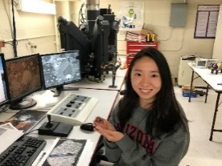
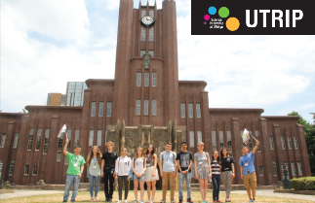
International Programs
Internships
Undergraduate
Graduate
SVAP
Study and Visit
Abroad Program
UGRASP
Undergraduate Research Abroad in Science Program
GRASP
Graduate Research
Abroad in Science Program
Outbound
For 3rd and 4th year students at the Faculty of Science
2 weeks to 3 months from May to March the following year
Financial support provided
7 participants（2019）
For 4th year students at the Faculty of Science
2 weeks to 3 months during the autumn semester
Financial support provided
3 participants（2019）
For students at the Graduate School of Science
2 weeks to 3 months from June to March the following year
Financial support provided
30 participants（2019）
UTRIP
The University of Tokyo Research Internship Program
UCEAP
University of California Education Abroad Program
GSI
Global Science Internship
GS-GSI
For students who have completed at least one full year, and are expected to return to, a Bachelor's degree program outside of Japan
6 weeks during the summer （to be selected from two designated periods）
Financial support provided
20 participants（2019）
For students from the University of California
6 weeks during the summer
No financial support
10 participants（2019）
For 1st to 4th year students
2 weeks to 6 months during any time of the year*
Financial support provided
5 participants（2019）
For students from selected partner universities （SPbU, MSU）
Inbound

Slide 9
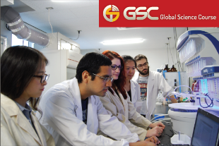
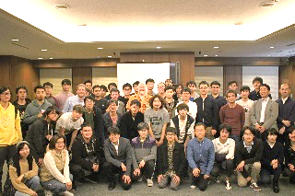
International Programs
Degree Programs in English
Undergraduate
Graduate
GSC
Global Science Course
GSGC
Global Science
Graduate Course
All-English undergraduate transfer program
Transfer into the School of Science (Dept. of Chemistry)
Fall admission（September）
2-year course （3rd + 4th year）
Graduate with a BSc degree
Financial support provided
4 newly admitted students （2019）
All-English graduate program
A 5-year integrated education scheme: Master’s and Doctoral program in sequence
Fall admission（September）
Faculty Guidance System: Plural Supervision
Graduate with Master’s degree + Doctoral degree Financial support provided
10 newly admitted Course Students（2019）
Inbound

Slide 10
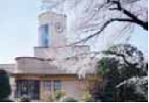
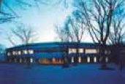
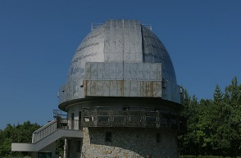
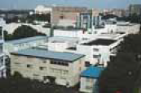
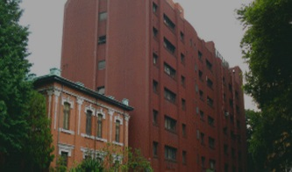
Affiliated Facilities
Botanical Gardens (Koishikawa, Nikko)
The Misaki Marine Biological Station (MMBS)
Research Center for Spectrochemistry (RCS)
Geochemical Research Center (GRC)
Institute of Astronomy (IoA)
Kiso Observatory
Center for Nuclear Study (CNS)
Research Center for the Early Universe (RESCEU)
Center for Ultrafast Intense Laser Science (CUILS)
Molecular Genetics Research Laboratory (MGRL)
Institute for Photon Science and Technology (IPST)
Universal Biology Institute (UBI)
UTokyo Organization for Planetary and Space Science (UTOPS)
Institute for Physics of Intelligence (iπ)

